Slide 1

InterSystems Challenge Intro

Slide 2

InterSystems Challenge for Rakathon 2026
Innovative solutions with interoperable healthcare data
For your project, use InterSystems IRIS for Health – for demonstrating interoperability, or implementing generative AI along with vector search or an agent-based approach.
CAN BE COMBINED WITH ANY OTHER CHALLENGE
Winner prize 1500 EUR
Innovation & real-world impact: a clear healthcare problem and path to MVP
Meaningful use of InterSystems technology with AI and/or FHIR
Technical coherence: a sound data model and architecture
Full challenge description, GitHub template and tutorials:
developer.intersystems.com/intersystems-challenge-at-rakathon-2026/
Notes:
InterSystems Challenge for Rakathon 2026: participants can leverage InterSystems IRIS for Health, InterSystems FHIR server, generative AI with vector search, or agent-based approaches to combine these technologies.
[Sources]
https://developer.intersystems.com/intersystems-challenge-at-rakathon-2026/
[/sources]

Slide 3
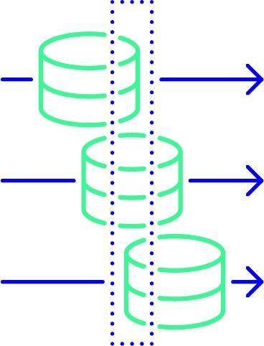
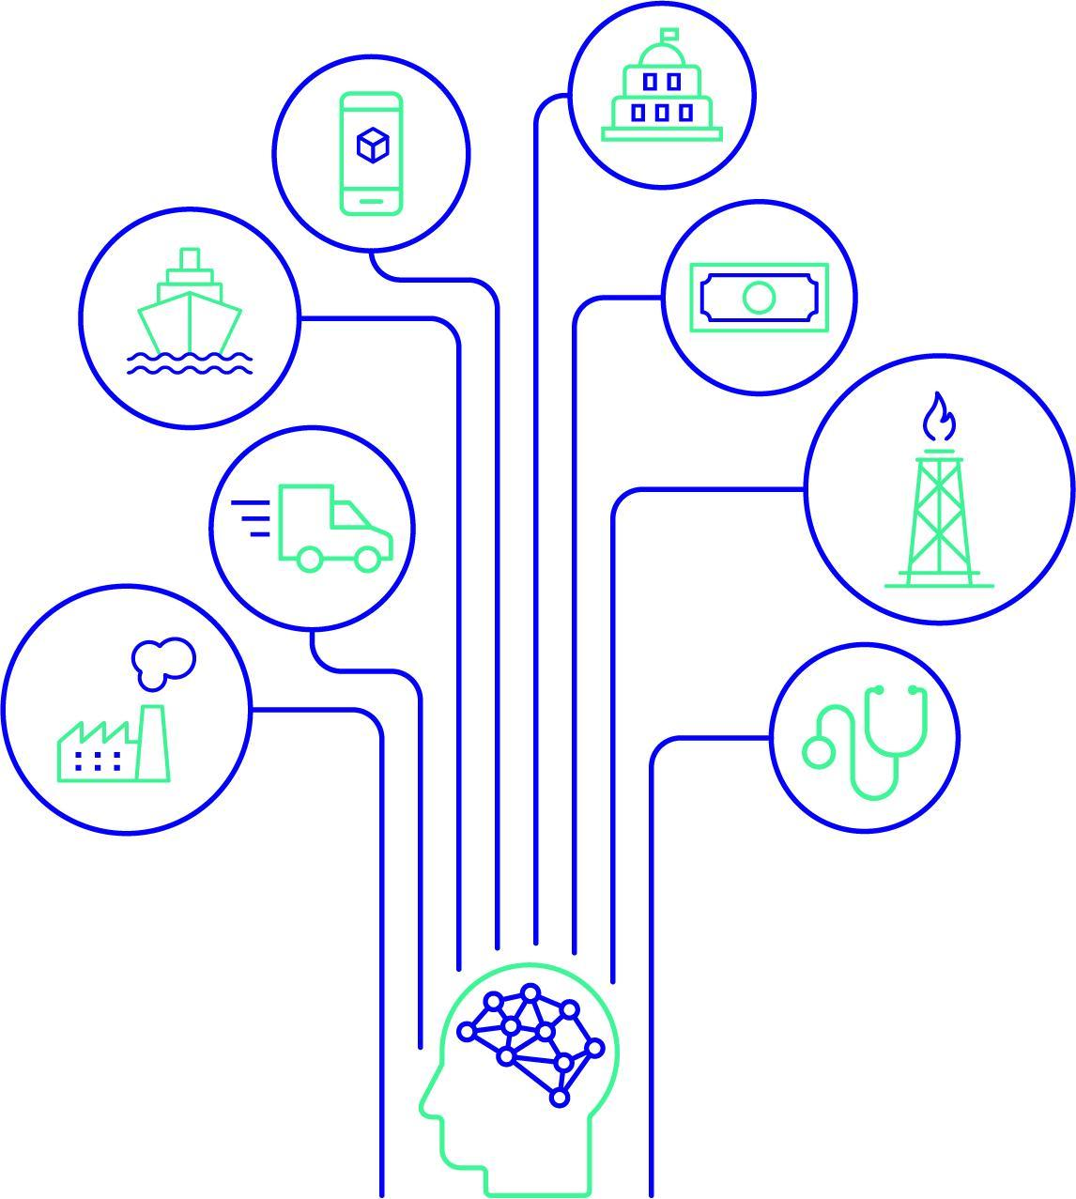

Retrieval-Augmented Generation (RAG)
User query
Retrieve relevant data from the IRIS database
Add context to the query for the LLM
Use InterSystems IRIS Vector Search to narrow down contextual information

Slide 4
Agent-based access to data using tools
Tools get data
SQL / API / FHIR / Vector Search
User of agent powered system
Agent (LLM)
Selects a tool
Repeats based on the tool call result
Leverage data in InterSystems IRIS through agent tools
Notes:
Agent-based data access: The user enters a query. The LLM selects the available instrument and its parameters. The application runs the tool, for example, for a SQL query or API call including FHIR, and returns the result of the model. The model can choose the next call or build the response. The tools work within the scope of the application's permissions. The schema intentionally preserves the level of abstraction of the previous slide.
[Sources]
https://developers.openai.com/api/docs/guides/function-calling
https://help.openai.com/en/articles/8555517-function-calling-in-the-openai-api
[/sources]

Slide 5






FHIR Server for interoperability and/or storage layer
Other clinical
systems
FHIR server
Your solution
InterSystems IRIS FHIR server enables data exchange with other systems
and can also serve as the solution’s storage layer.
Notes:
Conceptual architecture provided by the presenter: other clinical systems exchange data bidirectionally with the central FHIR repository, which exchanges data bidirectionally with the solution and can optionally serve as its storage layer.
[Sources]
User-provided content. Existing icons from Intersystems_icon_light.pptx, reused from this slide.
[/Sources]
[Sources]
Other clinical systems icons: user-provided Intersystems_icon_light.pptx. Intelligent chart review (slide 12), Health informatics platform (slide 18), Hospital (slide 7), Ambulance (slide 1), Clinical change (slide 2).
[/Sources]

Slide 6
Access to challenge data - Ostrava
Two ways to request access to the datasets for your challenge
1. Contact an InterSystems mentor in person
2. Contact an InterSystems mentor on Slack
Speak to a mentor and ask for access to the data for your chosen challenge.
Message a mentor on Slack and specify which challenge data you need.
Data for the VZP challenges is available in Azure.
6

Slide 7
Access to challenge data - Brno
For Brno challenges, contact the challenge owners directly or their technical support team.
1. In person
2. On Slack
Ask the challenge owner or their technical support team for data access.
Message the challenge owner or their technical support team to request data access.
Data for the VZP challenges is available in Azure.
7

Slide 8
Access to challenge data - Prague
The contact for data access depends on your chosen challenge.
Smart Onco AA and
MDT Copilot
All other challenges
Contact an InterSystems mentor in person or on Slack to request access to the challenge data.
Contact the challenge authors directly or their technical support team to request data access.
Data for the VZP challenges is available in Azure.
8

Slide 9

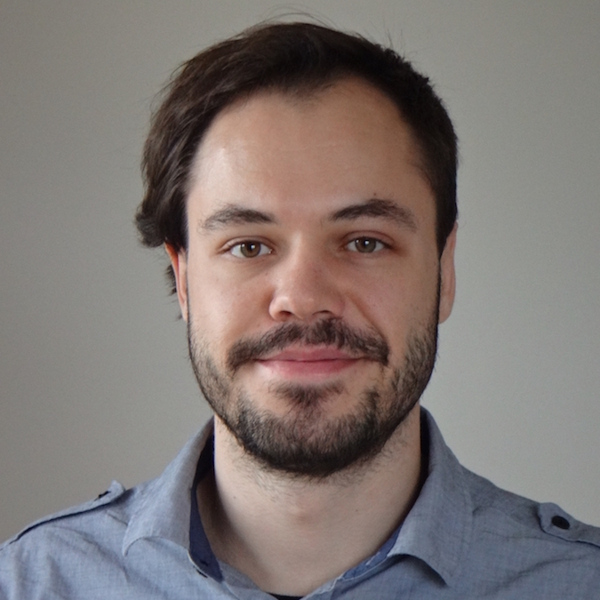
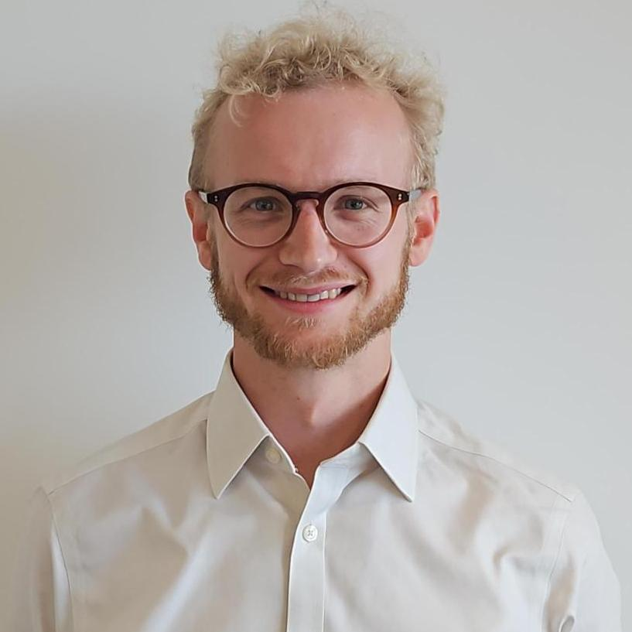
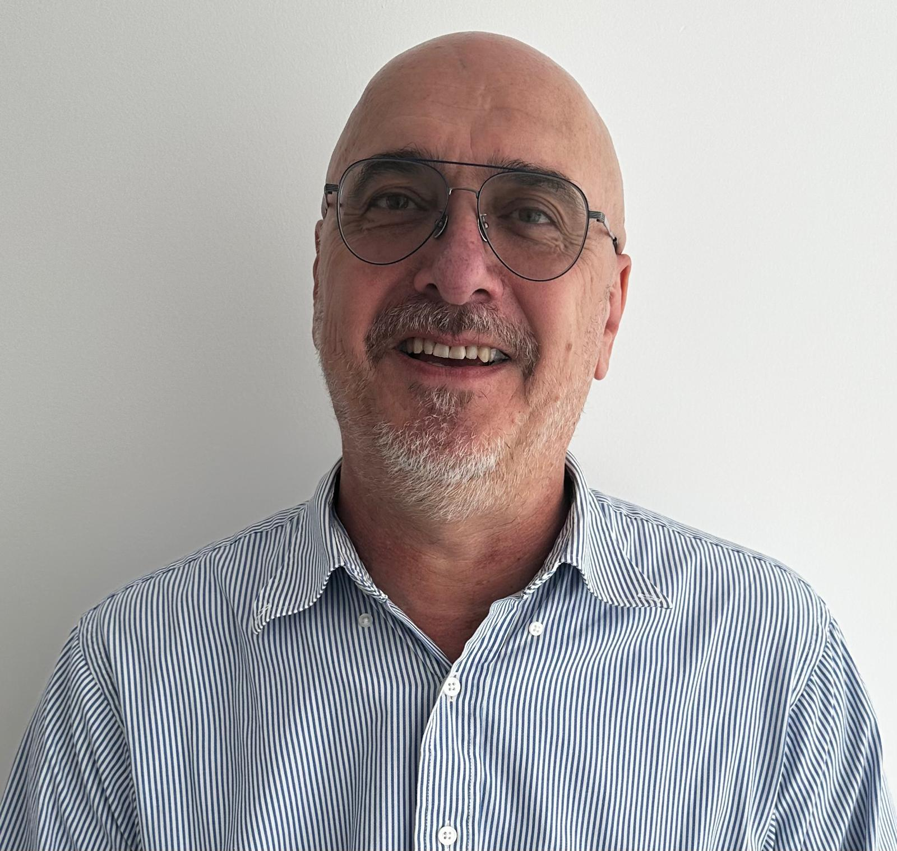
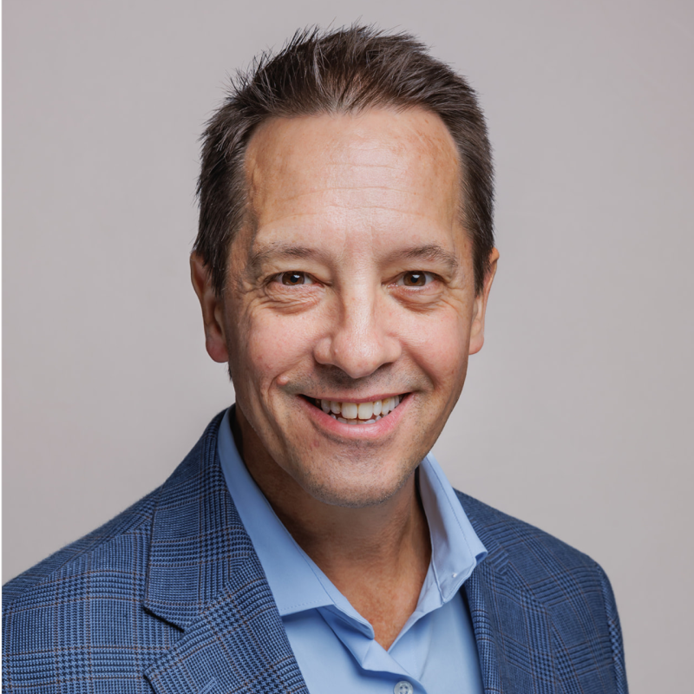
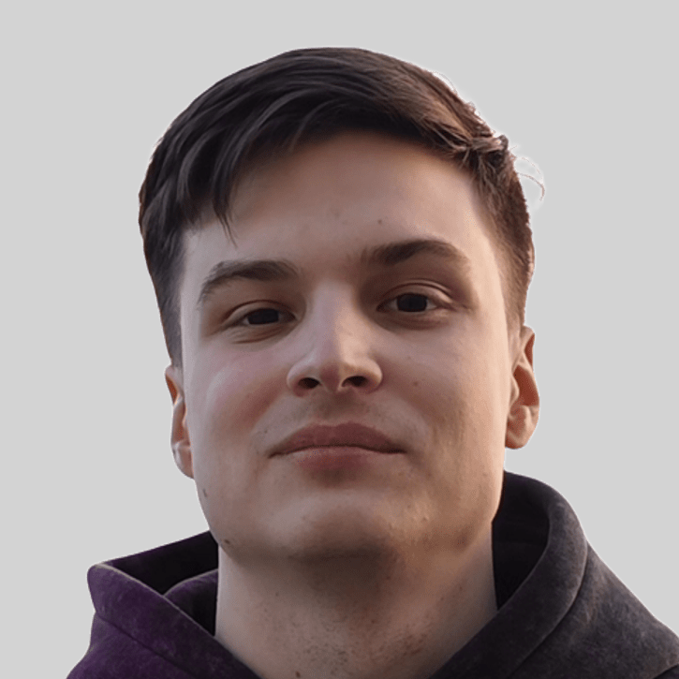
InterSystems mentors at Rakathon
Prague
Ostrava
Prague
Ostrava
Ondřej
Hoferek
Gabriel
Ing
Daniel Kutáč
Brno
Online mentors
24/7 Help & Coverage
Brno
Henry Hamon Pereira
Fri 20:00 – 24:00
José Roberto Pereira
Thomas
Dyar
Daniil
Drozdov
Sat 0:00 – 4:00
Semen Makarov
Sat 4:00 – 8:00
Notes:
Distribution of mentors and photos: user documents, 14/10/2026. Prague: Ondřej Hoferek and Gabriel Ing. Brno: Daniil Drozdov and Thomas Dyar. Ostrava: Daniel Kutáč. Photo of Ondřej: user background, 10/14/2026. Map: AI-created schematic silhouette of the Czech Republic; The locations of the cities are approximate.

Slide 10


You can find us ...
InterSystems Booth
Slack:
#best-use-of-intersystems-technology-for-ai-and-fhir
#08-tech-helpdesk
Notes:
This is the primary slide used for titles/opening. There are 5 alternative layouts that can be used when needed.
You can access the alternative layout options by:
- Right clicking on the slide thumbnail on the left-hand side > Layout > choose from Title Slide, Title Slide (dark), Title Slide (picture), Title Slide (picture dark),
and Title Slide (option B).
The pre-set type sizes and type size recommendations for the Title slides’ title text placeholders are guidance only, if the title is much longer or shorter than the font size allows, it can be either increased or decreased.

